Slide 1
Common Domain Model
ISDA & Rosetta DSL

Slide 2
What is CDM
CDM is a standardised, machine-readable and machine-executable blueprint for how financial products are traded and managed across the transaction lifecycle.
The product scope of the CDM includes OTC derivatives, cash securities, securities financing, and commodities.
CDM currently cover post-trade lifecycle process
Built using Rosetta DSL
Variety of data representations: FIX, FpML, ISO 20022, EFET
Syntax: Can create new component/ extend /edit existing component
Use Java code generator to generate JAR file
Notes:
Post-trade processing occurs after a trade is complete. At this point, the buyer and the seller compare trade details, approve the transaction, change records of ownership, and arrange for the transfer of securities and cash. Post-trade processing is especially important in markets that are not standardized, such as the over-the-counter (OTC) markets

Slide 3
CDM Modeling Dimensions
Product
Event
Legal Agreement
Process
Reference Data
Mapping (Synonym)
Namespace

Slide 4
Products
Where applicable, the CDM follows the data structure of the Financial Products Markup Language (FpML)
Tradable Product:
Financial product that is ready to be traded: Product, price, quantity, and other details
Contractual Product:
Interest rate derivatives
Credit derivatives
Equity derivatives
Options
Securities Lending
Notes:
https://docs.rosetta-technology.io/cdm/documentation/source/documentation.html#product-model

Slide 5
Primitive Events
Primitive events are the building block components used to specify business events in the CDM
They describe the fundamental state-transition components that impact the trade state during its lifecycle
The trade state always transitions from and to a TradeState data type.
Primitive Event include:
ExecutionPrimitive
ContractFormationPrimitive
SplitPrimitive
QuantityChangePrimitive
ResetPrimitive
TermsChangePrimitive
TransferPrimitive

Slide 6
Business Event
A Business Event represents a transaction lifecycle event and is built according to the following design principle in the CDM:
Business events are specified by composition of primitive events,
A business event is atomic in the sense that its underlying primitive event constituents cannot happen independently

Slide 7
Workflow
A workflow represents a set of actions or steps that are required to trigger a business event
A workflow is organised into a sequence in which each step is represented by a workflow step.
A workflow may involve multiple parties in addition to the parties to the transaction, and may include automated and manual steps.

Slide 8
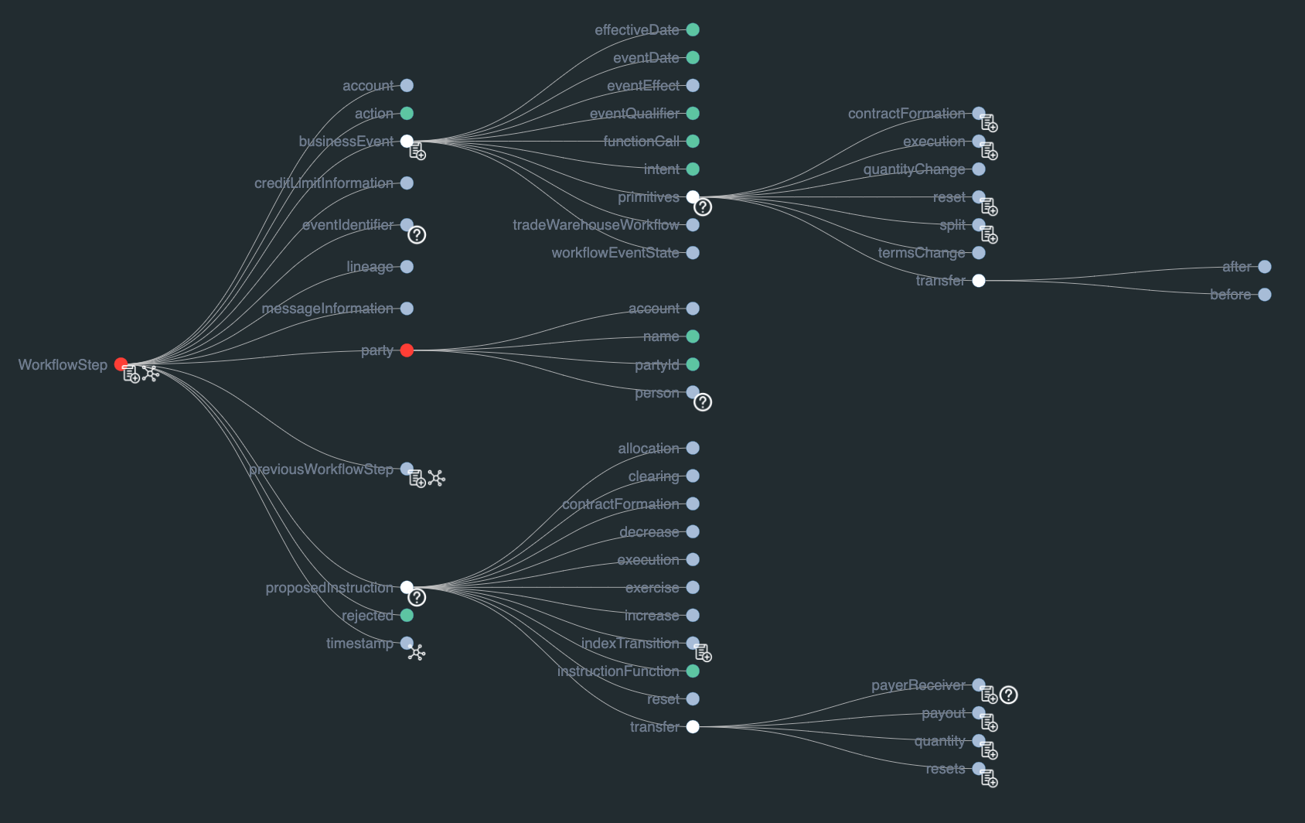

Slide 9
Workflow Instructions
AllocationInstruction
ClearingInstruction
ContractFormationInstruction
ExecutionInstruction
ExerciseInstruction
ResetInstruction
TransferInstruction
IncreaseInstruction
DecreaseInstruction
IndexTransitionInstruction

Slide 10
Reference Data Model
Party
Legal Entity

Slide 11
Mapping
In order to translate to industry existing messages, CDM provide features to convert CDM data to:
FpML standard
FIX standard
ISO 20022 standard
DTCC
CME
AcadiaSoft
ISDA Create
ORE XML

Slide 12
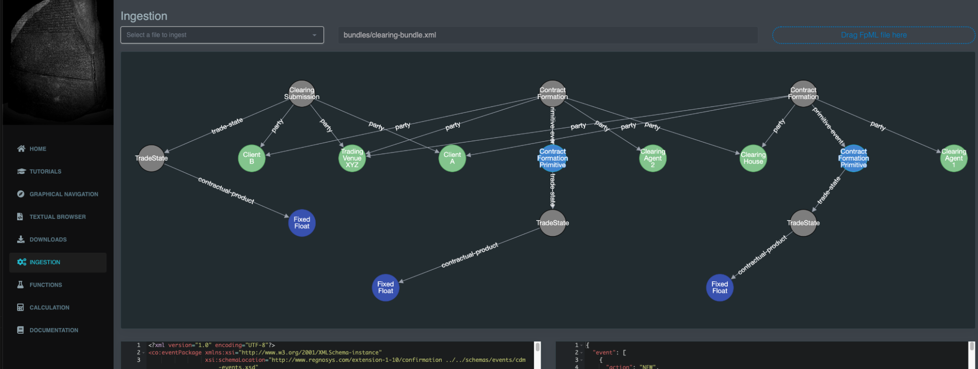
Try Ingestion Example
Notes:
https://portal.cdm.rosetta-technology.io/#/ingestion

Slide 13
References
https://docs.rosetta-technology.io/cdm/documentation/source/documentation.html
https://docs.rosetta-technology.io/dsl/readme.html#what-is-the-rosetta-dsl
https://portal.cdm.rosetta-technology.io/#/ingestion
https://portal.cdm.rosetta-technology.io/#/graphical-navigation
https://www.investopedia.com/ask/answers/052815/what-overthecounter-derivative.asp
https://www.investopedia.com/terms/p/post-trade-processing.asp

